Slide 1

MAIM
ML FINAL
PROJECT
BY :MOHAMED AHMED MOHAMED HOSSEN

Slide 2

MAIM
THIS PROJECT RUNS
THESE MODELS...
linear regression
random forest
logistic regression

Slide 3

MAIM
OVERVIEW
In this presentation we will go through.......
INTRODUCTION
DATA CLEANING
DATA PREPROCCESING
STANDARDIZATION
WORD CLOUD
LINEAR REGRESSION
LR VISUALIZATION
RANDOM FOREST
RF VISUALIZATION
LOGISTIC REGRESSION
LR VISUALIZATION
THANK YOU

Slide 4
MAIM
INTRODUCTION
In this notebook, we are trying to train a model to predict whether the song would be popular or not.
githup

Slide 5

MAIM
R^2 = -6.16
The methods used
Compute cost
Compute gradient
gradient descents
visualization
LINEAR REGRESSION

Slide 6
MAIM
COMPUTE COST
FUNCTIONALITY
It calculates the predicted popularity (f_wb_i) using the dot product of the features and weights, plus the bias.
It subtracts the actual popularity (y.iloc[i]) from the predicted value to get the error.
It squares the error to penalize larger deviations.
This method defines a function named compute_cost that calculates the Mean Squared Error (MSE) cost function for a linear regression model.

Slide 7
MAIM
COMPUTE GRADIENT
FUNCTIONALITY
The function iterates through each song in the dataset.
For each song, it calculates the difference (err) between the predicted popularity and the actual popularity.
It then uses this error to update the gradients:
For each weight (dj_dw), it adds the product of the error (err) and the corresponding feature value (X.iloc[i]). This essentially tells us how much changing that weight by a small amount would affect the error for this song.
For the bias (dj_db), it simply adds the error itself.
Finally, it averages these accumulated updates for weights and bias across all songs
The compute_gradient function calculates the gradients of the cost function with respect to each weight (w) and the bias (b) in a linear regression model. These gradients indicate how much changing a particular weight or bias would affect the overall cost (error) of the model.

Slide 8
MAIM
GRADIENT DESCENT
FUNCTIONALITY
Initialize parameters: Sets initial values for the weights (w) and bias (b).
Iterative optimization:
Computes the gradients of the cost function using the gradient_function.
Updates the weights and bias using the gradients and the learning rate (alpha).
Calculates the new cost using the cost_function.
Stores the cost and weights in history lists for tracking.
Prints the cost at regular intervals to monitor progress.
Return optimized parameters: Returns the final optimized weights, bias, cost history, and weight history.
The gradient_descent function implements the gradient descent optimization algorithm to minimize the cost function for a linear regression model. It iteratively updates the model's weights and bias to find the optimal values that minimize the cost.

Slide 9

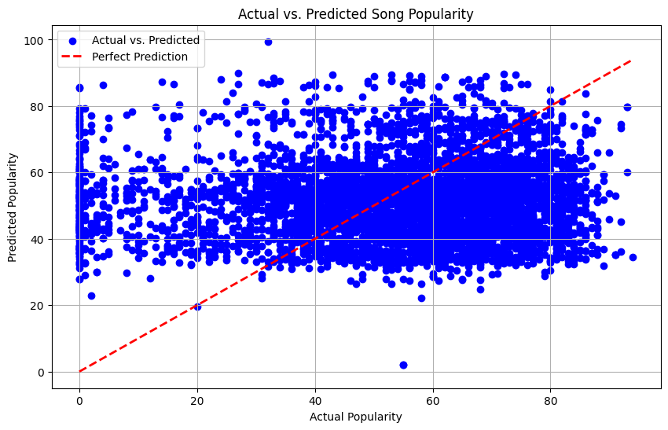
MAIM
RESULT
Mean Squared Error (MSE): 3387.17 ⚠️
- This value indicates that, on average, the model's predictions deviate from the actual popularity by a large margin. A high MSE suggests that the model is not performing well.
- R-squared Score: -6.16 ❌
- The R-squared score is negative, which implies that the model performs worse than a simple horizontal line (i.e., the mean of the target variable). This means the model is unable to explain the variability in the data.
The scatter plot above (Actual vs. Predicted Song Popularity) shows a lack of strong correlation between the actual and predicted values. The red dashed line represents perfect prediction, and the points should be closely aligned with this line in a well-performing model. However, the data points are widely scattered around the line, further indicating poor model fit.

Slide 10

ACCURECY =0.7047
MAIM
The methods used
Create tree
Predict tree
Create forest
Predict forest
Train random forest
Predict random forest
RANDOM FOREST
www.reallygreatsite.com

Slide 11
MAIM
CREATE TREE
Functionality
The create_tree function recursively builds a decision tree for a machine learning model. It's a core component of decision tree algorithms.
Stopping criteria: Checks if the current node should be a leaf node based on maximum depth, minimum samples, or pure data (all samples belong to the same class).
Feature selection: Randomly selects a feature to split the data on.
Threshold determination: Chooses a threshold value for the selected feature to split the data into left and right branches.
Recursive construction: Recursively calls itself to build left and right subtrees using the split data.
Node creation: Creates a node representing the current decision, including the feature, threshold, and left/right subtrees.

Slide 12
MAIM
PREDICT TREE
Functionality
The predict_tree function traverses a decision tree to make a prediction for a given input instance (represented as a feature vector x).
Check node type: If the current node is a dictionary (representing an internal node with branches), it proceeds to the next step. If it's a float (representing a leaf node), it directly returns the predicted class or value.
Feature comparison: Extracts the feature value (feature_value) for the current input instance using the index stored in the node (tree['feature_idx']).
Threshold check: Compares the extracted feature value with the threshold stored in the node (tree['threshold']).
Recursive prediction: If the feature value is less than or equal to the threshold, it recursively calls predict_tree on the left subtree. Otherwise, it calls predict_tree on the right subtree.

Slide 13
MAIM
CREATE FOREST
Functionality
The create_forest function constructs a random forest ensemble, which is a collection of decision trees. It's a popular ensemble method that combines the predictions of multiple decision trees to improve overall performance and reduce overfitting.
Initialize forest: Creates an empty list forest to store the individual decision trees.
Iterate over estimators: Loops n_estimators times to create the specified number of decision trees.
Bootstrap sampling: For each tree, randomly samples the training data with replacement using np.random.choice. This creates a bootstrap sample of the same size as the original data but with potential duplicates.
Tree creation: Calls the create_tree function to build a decision tree using the bootstrap sample.
Append to forest: Adds the newly created tree to the forest list.
Return forest: Returns the complete random forest ensemble.

Slide 14
MAIM
PREDICT FOREST
Functionality
The predict_forest function makes predictions using a random forest ensemble. It iterates through each input instance in X, predicts the class or value for each instance using every decision tree in the forest, and then averages the predictions to obtain the final prediction.
Iterate through instances: Loops through each input instance x in the X array.
Predict with each tree: For each instance, calls the predict_tree function on every decision tree in the forest. This collects a list of predictions from all trees.
Average predictions: Takes the average of the predictions from all trees for the current instance.
Return predictions: Returns an array containing the predicted values for all input instances.

Slide 15
MAIM
TRAIN RANDOM FOREST
Functionality
The train_random_forest function serves as a wrapper for the create_forest function, providing type checking and input validation. It ensures that the input data (X and y) are in the correct format (numpy arrays or pandas DataFrames/Series) and have compatible dimensions. It also checks that the features in X
Type checking: Verifies that X and y are either numpy arrays or pandas DataFrames/Series.
Dimension check: Ensures that the number of rows in X matches the number of elements in y.
Numeric data check: Checks if all elements in X are numeric.
Call create_forest: If all checks pass, calls the create_forest function to build the random forest using the provided data and parameters.

Slide 16
MAIM
PREDICT RANDOM FOREST
Functionality
The predict_random_forest function serves as a wrapper for the predict_forest function, providing type checking and input validation. It ensures that the input data (X) is in the correct format (numpy array or pandas DataFrame) and contains only numeric data.
Type checking: Verifies that X is either a numpy array or pandas DataFrame.
Numeric data check: Checks if all elements in X are numeric.
Call predict_forest: If all checks pass, calls the predict_forest function to make predictions using the random forest.

Slide 17
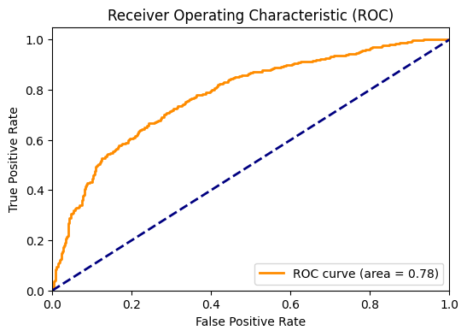
MAIM
RESULT
Accuracy: 0.705407586763519 🎉
The overall accuracy of the random forest model is 70.54%, indicating that it correctly classified 70.54% of the instances.
Class 0 (Low Popularity):
Precision: 70% - Out of all instances predicted as class 0, 70% were actually class 0.
Recall: 31% - Out of all actual class 0 instances, 31% were correctly predicted as class 0.
F1-score: 43% - The F1-score balances precision and recall.
Class 1 (High Popularity):
Precision: 70% - Out of all instances predicted as class 1, 70% were actually class 1.
Recall: 93% - Out of all actual class 1 instances, 93% were correctly predicted as class 1.
F1-score: 80% - The F1-score balances precision and recall.
This ROC curve provides a visual summary of the model's ability to distinguish between classes, with the AUC serving as a single metric to quantify its overall performance.

Slide 18

ACCURECY =0.724
MAIM
The methods used
Compute cost
Gradient descent
Predict
LOGISTIC REGRESSION

Slide 19
MAIM
COMPUTE COST (LOGISTIC)
1. Finding Training Examples (m):
m = len(y): This line counts the number of elements in the target vector y. This tells us how many training examples we have in the dataset.
2. Predicting Probabilities (h):
h = sigmoid(X.dot(weights)): This line calculates the predicted class probabilities for each example. It does this in two steps:
Dot product (): It multiplies each feature in X by its corresponding weight in weights and sums the products. This gives us a preliminary score based on the features.
Sigmoid function (): It applies the sigmoid function to the score from the dot product. This function squashes the score between 0 (low probability) and 1 (high probability).
FUNCTIONALITY
This function calculates the cost (error) of a Logistic Regression model for a given dataset. It represents how well the model's predictions (represented by h) align with the actual target values (y).

Slide 20
MAIM
COMPUTE COST (LOGISTIC)
3. Clipping Probabilities (h):
h = np.clip(h, 1e-10, 1 - 1e-10): This line prevents errors during cost calculation. It ensures the predicted probabilities (h) stay within a safe range (between a very small positive number and a very small number less than 1) because we can't take the logarithm (log) of 0 or 1. Think of it as putting a tiny buffer around 0 and 1 to avoid calculation issues.
4. Calculating Cost:
cost = ...: This line calculates the overall error (cost) of the model's predictions. It uses a formula that considers both how well the model classified correct examples and how much penalty it gets for incorrect classifications.
The provided explanation already simplified the technical aspects, so this rewrite focuses on using concise language and emojis to convey the key ideas.
FUNCTIONALITY
This function calculates the cost (error) of a Logistic Regression model for a given dataset. It represents how well the model's predictions (represented by h) align with the actual target values (y).

Slide 21
MAIM
GRADIENT DESCENT (LOGISTIC)
FUNCTIONALITY
Initialization:
m = len(y): Counts the number of training examples (m).
cost_history = []: Creates an empty list to store cost values in each iteration.
Iteration Loop:
Loops for a specified iterations to iteratively adjust weights.
This function iteratively improves the weights of a Logistic Regression model to minimize the cost (error) of its predictions.

Slide 22
MAIM
GRADIENT DESCENT (LOGISTIC)
Weight Update:
weights = weights - ...: This line updates the weights based on the following steps:
Gradient Calculation: It calculates the gradient, which indicates how much changing each weight would affect the overall cost. This involves:
Using the dot product of features (X) and current weights to get a preliminary score.
Applying the sigmoid function to get predicted probabilities.
Comparing predicted probabilities with actual target values (y) to find the error.
Multiplying the error by the transposed features (X.T) to distribute the error based on feature contributions.
Learning Rate Adjustment: This scales the gradient by the learning rate (learning_rate). The learning rate controls the step size of the weight updates.
FUNCTIONALITY
This function iteratively improves the weights of a Logistic Regression model to minimize the cost (error) of its predictions.

Slide 23
MAIM
PREDICT (LOGISTIC)
FUNCTIONALITY
Weighted Sum:
np.dot(X, weights): This calculates a weighted sum for each data point in X. It multiplies each feature in X by its corresponding weight in weights and then sums the products. Think of it as combining the features with their importance (weights) to get a preliminary score.
Sigmoid Threshold:
sigmoid(...) >= 0.5: This line utilizes the sigmoid function and a threshold to predict class labels:
sigmoid(...): This part applies the sigmoid function to the weighted sum from step 1. Remember, the sigmoid function squashes values between 0 and 1, representing class probabilities.
>= 0.5: This compares the result of the sigmoid function with a threshold of 0.5.
This function takes features (X) and the trained model's weights (weights) and predicts class labels for unseen data points.

Slide 24
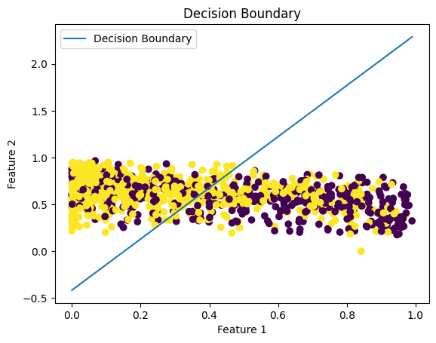
MAIM
RESULT
Accuracy: 0.7247780468119451 📊
The overall accuracy of the logistic regression model has improved to 72.48%, indicating that it correctly classified 72.48% of the instances.
The logistic regression model shows a significant class imbalance issue, with a strong bias towards predicting class 1. It performs well in predicting high-popularity songs (class 1) but completely fails to predict low-popularity songs (class 0). This could be due to the data imbalance or the model's limitations in capturing the nuances of low-popularity songs.
Decision Boundary:
* This plot visualizes the model's decision-making criteria.
* It shows a line that separates the two classes in the data.
* Points on one side of the line belong to one class, while points on the other side belong to the other.

Slide 25
MAIM
THANK YOU
I really enjoyed this project
BY : MOHAMED AHMED

